Slide 1
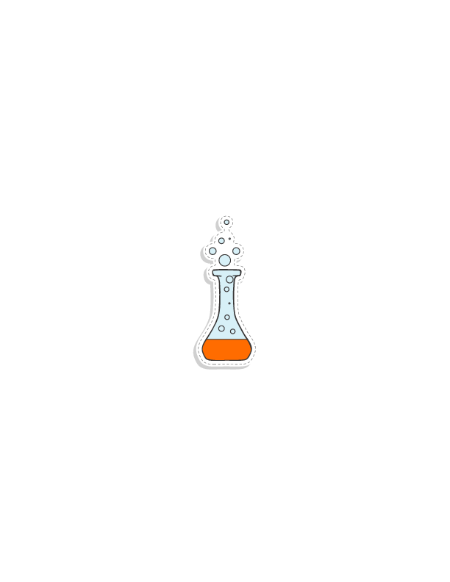
Welcome to: The Science Behind Food
Katie Sudler
Notes:
We will have a great time today, but #1 most important is your safety.
*Restrooms
*Emergency Exits & Meeting place
Any Q throughout the day – how can we help you – LOOK FOR – cell number of someone that can help!

Slide 2
Food Science
As consumers, it’s pertinent to know more about the food we consume!
We are all familiar with food! And typically have a lot of questions about food, too.
Inherent interest
Interdisciplinary
Students love playing with their food!
Taste the “science”.
Source: Schmidt, S.J., Bohn, D.M., Rasmussen, A.J., Sutherland, E.A. (2012). Using Food Science Demonstrations to Engage Students of All Ages in Science, Technology, Engineering & Mathematics (STEM). Journal of Food Science Education 11: 16-22
Notes:
Interdisciplinary – many different subject areas feed into the food industry.
Cultural studies, art, psychology, math, chemistry, biology, culinary arts, business, communications, physics, engineering, design, to name a few!

Slide 3
Food Science & NGSS
NGSS: Disciplinary Core Ideas
Notes:
Next Generation Science Standards are National Science standards that almost every state has adopted. The standards emphasize hands on learning & critical thinking.
The science standards and IFT's focus and core areas overlay the science standards nicely.
Here is a great place to talk about IFT as a tool to use for information about the industry, lessons, demonstrations, etc.

Slide 4
What is Food Science?
Sensory
Sensory
Chemistry
Engineering
Microbiology & Quality
Biochemistry
Areas of Study
Horticulture & Animal Sciences
Laws & Regulations
Marketing & Business
Material Science &
Packaging
Nutrition
Statistics
Physics
Biology
Notes:
Many people do not know that there are Careers in food science, even fewer know that you can get a college degree in 'food science.'
You can study food science in college and each of the Peripheral areas of study are all touched on when someone is getting a degree in food science. OR, you can get a degree in any of the peripheral areas and work in the food industry or as a food scientist.

Slide 5
What is Food Science?
Sensory
Starches
Gums
Vitamins & Minerals
Proteins
Water
Food Additives
Food Matrix
Enzymes
Starches
Proteins, Amino Acids & Peptides
Phytochemicals
Cellulose
Lipids
Sugar
Pectin
Sugar Substitutes
Notes:
While in school, food scientists study and learn about food ingredient interactions and what their purpose in food is.
Each food ingredient on the label of cereal, yogurt, ice cream has a purpose. Each ingredient costs money and has a reason for being included in the food.

Slide 6
Food Scientists understand -
Sensory
Pasteurization
Dehydrating
Freezing
Canning
Drying
Irradiation
Food
Preservation & Processing
Jellying
Extrusion
High Pressure
Freeze drying
Sugar
Salting/Pickling
Smoking
Fermentation
Vacuum Packing
Notes:
How a food is packaged/processed & preserved – determines the shelf life, stability, how a product is stored at home or in the grocery.
Temp (high or low)
Water activity – low
Oxygen – low
pH - Low

Slide 7
Food Science & STEM
Google: “Comprehensive Review in Food Science & Food Safety ‘Feeding The World Today & Tomorrow’”
Notes:
There are many areas of study in food science. You can see on this document how Cell Biology, Microbiology, Engineering and more are used in the food industry.

Slide 8
Food Science & STEM
Article has 6 Demos!
Written by University of Illinois Food Science professors.

Slide 9
Food Technology is….
Food Technology is the application of food science principles and knowledge to the:
Selection
Preservation
Processing
Packaging
Distribution
and Use
of safe, nutritious & wholesome food.

Slide 10
Food Science & you
It is important to understand how science, technology & society are interrelated.
We need to challenge each other to build on what is already known– connecting what is learned in a science class & in our lives in the world.
Take each concerns, interests & experiences and connect them to each subject learned in school, using scientific knowledge & critical thinking.
Notes:
Food Science & your students
Your students need to understand how science, technology & society are interrelated.
Challenge our students to build on what they already know– connecting what is learned in a science class & their lives in the world.
Take the concerns, interests & experiences of students and connect them to the classroom, using scientific knowledge & critical thinking.

Slide 11
Why is this important?
Food Science is a critical part to feeding the world’s growing population.
Global food demand is expected to increase by 50% by 2030.
Many career opportunities!
Leading field in science related careers.

Slide 12
Food Industry Facts
One of the largest Manufacturing sectors in US!
1 in 3 jobs globally are Agriculture related.
Global food market = $4.2 T
Industry relies heavily on increased technology & greater automation.
Annual food spending/person continues to increase.
Consumers demand Convenience, Diverse & Healthy products

Slide 13
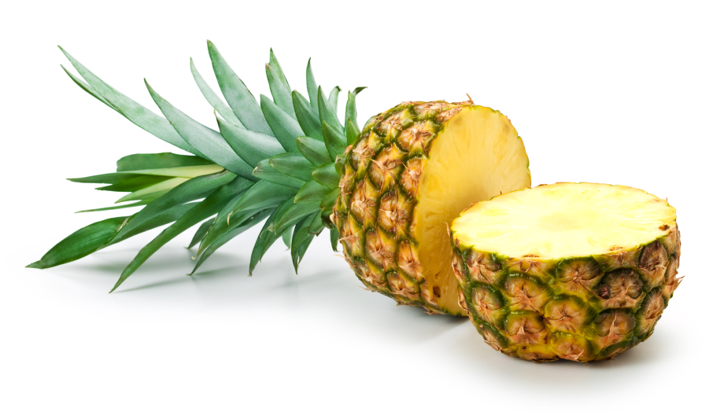
Food Industry Facts
Currently - Feed 7.7 Billion people, worldwide!
2050 – population will be 9.7 Billion
Need to reduce waste:
Food loss – before food gets to consumers
Food waste - consumer (home, restaurants)
Confusion around Use by, sell by, best by dates on food products
25% world’s food calories & 50% of total food weight lost or wasted before

Slide 14
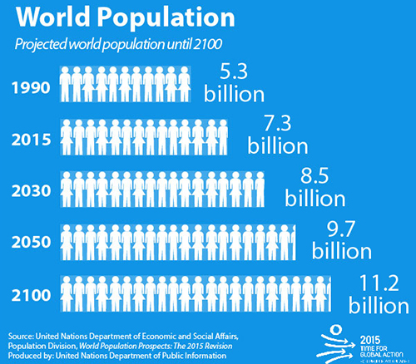
Global Population - Hunger
1:9 people worldwide are hungry
Asia & Africa have the highest levels of hunger
Asia & Africa have the biggest projected population growth.
http://www.foodaidfoundation.org
https://www.worldhunger.org
http://www.un.org

Slide 15
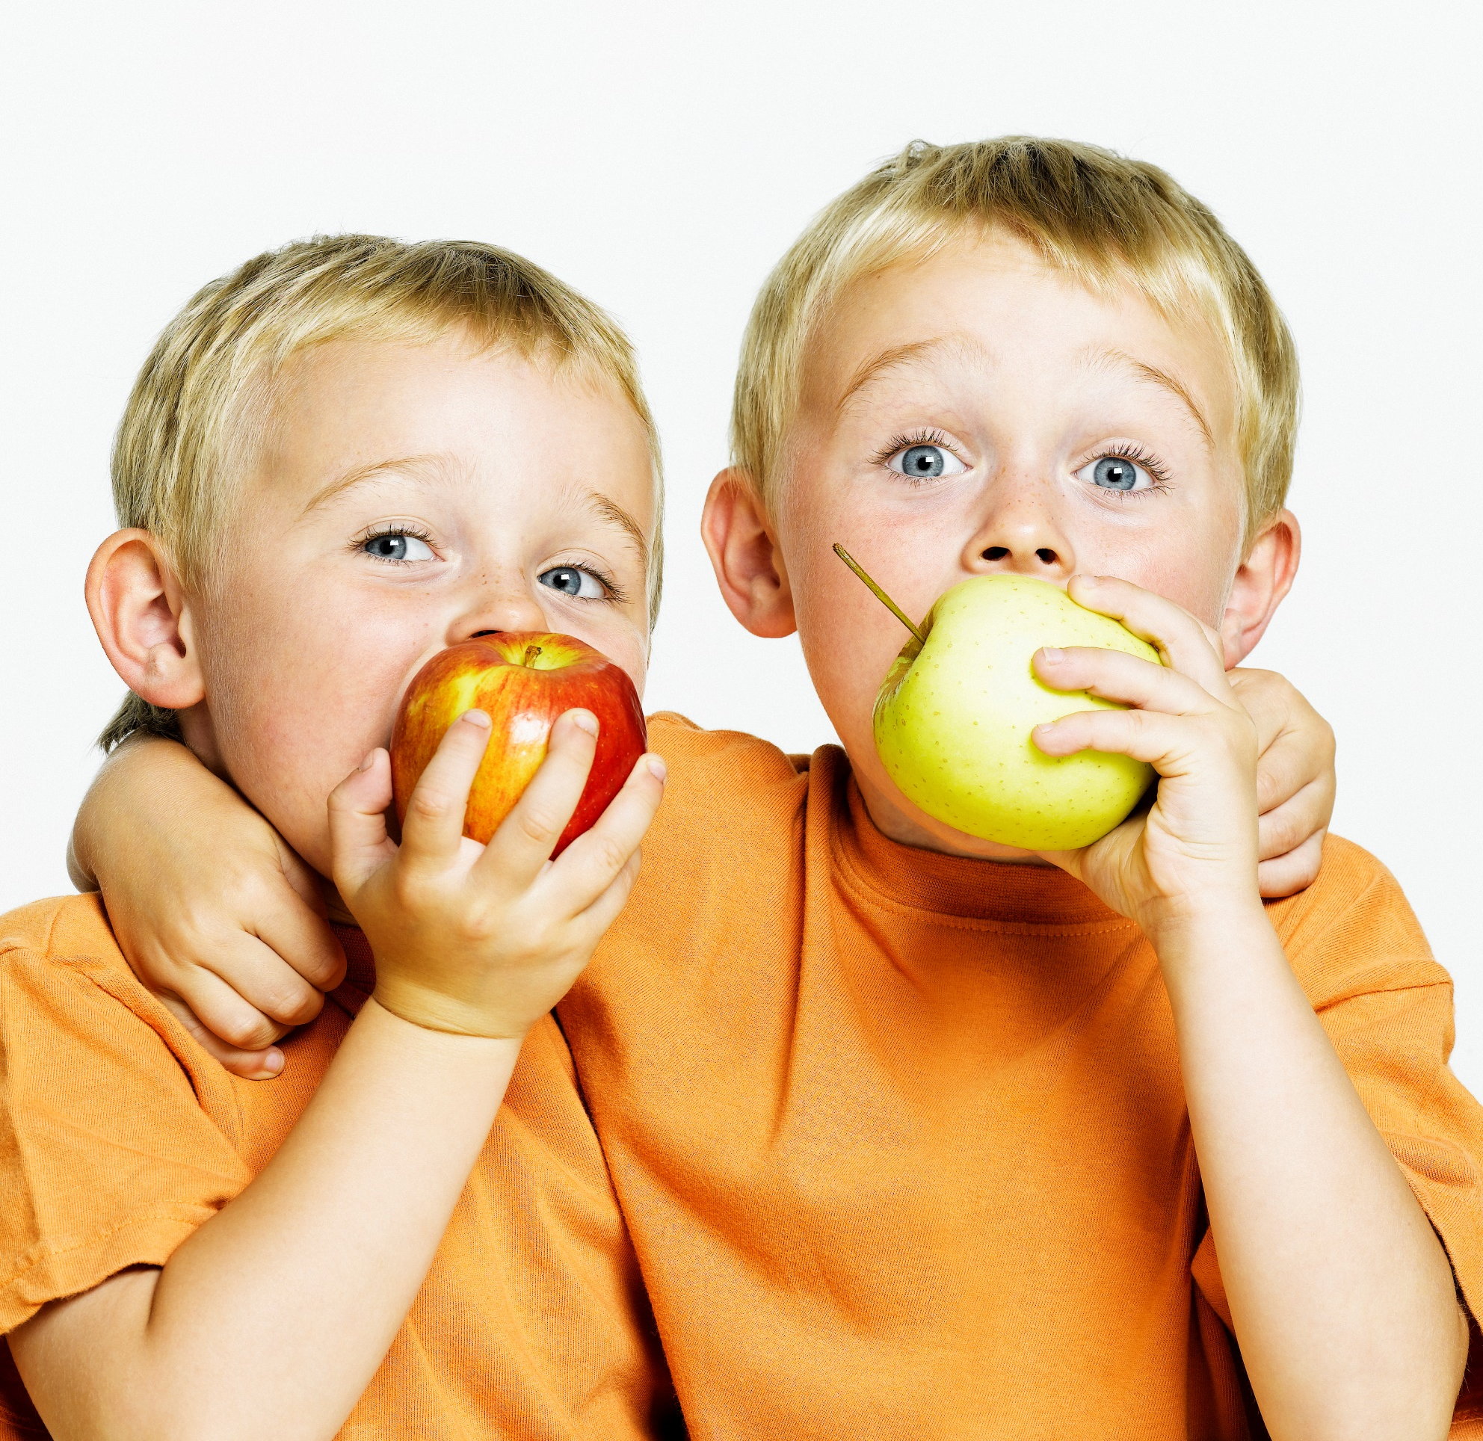
Food insecurity
In the US:
12.7% households had food insecurity at some point in the year
5% experience very low food security
Children in 7.8% of households are food insecure
Globally, children under 5:
5.6% are overweight
7.5% are wasting
22.2% are stunting
“Poverty is the principle cause of hunger, hunger is a cause of poverty.” www.worldhunger.org
Notes:
Children are the most visible victims of undernutrition
45% of all child deaths occur from poor nutrition (Global Nutrition Report, 2015)
MALnutrition is both overweight & undernourished
CAUSES:
Poverty
Conflict (more than ½ all hungry people live in countries affected by poverty (75% of stunted children)
Yemen, Nigeria, Congo, Afghanistan, Syria, Sudan, Somolia
Climate change-2016 El Nino responsible for conditions leading to severe insecurity for 20 million people
Drought, flooding, hurricanes, monsoons, cyclones, etc

Slide 16
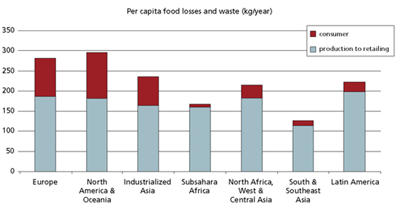
Food Industry Facts
1/3 all food produced is lost or wasted
Food loss – industry
Food waste - consumer
Use by, sell by, best by dates on food products*
Notes:
Food label dates – cost US consumers $29 billion & 129 billion pounds annually (IFT-Companies commit to simplify food date labels by 2020)
400 Companies across 70 countries commit to simplify food date labels by 2020
As many lower class across the world are becoming “middle class”, they demand more protein (meat & seafood) – putting a bigger strain on food supplies.
Food loss
Food Waste
Currently, we waste 1.6 billion tons of food annually, worth about $1.2 trillion dollars.
By year of 2030, 2.1 bn tonnes of food is wasted
(https://www.weforum.org/agenda/2018/08/global-food-waste-could-rise-by-a-third-by-2030-study)
http://www.fao.org/save-food/resources/keyfindings/en/

Slide 17
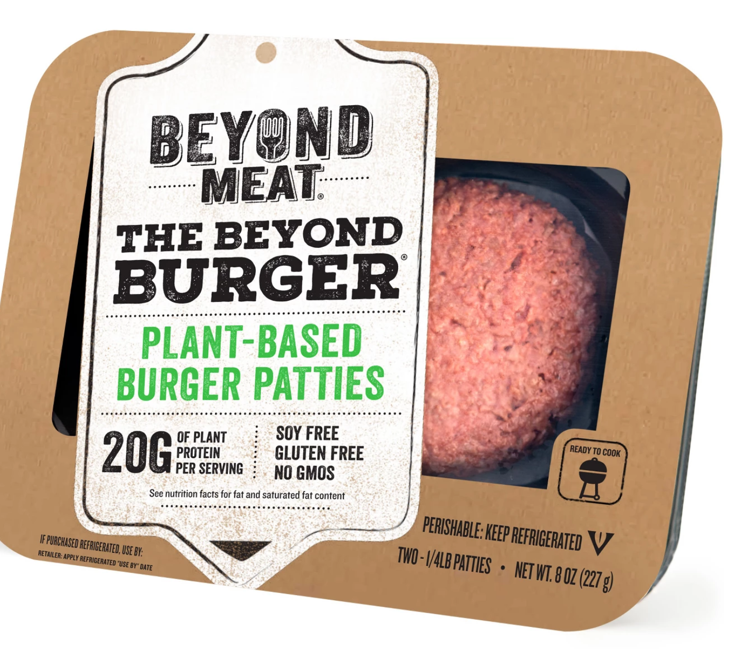
Hot Food Industry Topics
Emerging technologies - Biosensors
Food Health & Nutrition
Food safety & Defense - Product Recall
Feeding the world & clean, fresh water
Choosing foods that require less water
Alternatives – meat & dairy
Eco-Conscious packaging
“Food safety testing Market by Technology (traditional vs. rapid), by contaminant (pathogens, toxins, GMOs, pesticides and others), by Application (meat/poultry, dairy, process food, fruit/vegetables)
Global demand for food safety testing market USD 4.8 billion in 2015, USD 8.04 billion in 2021 (CAGR of 7.8%)
Quality Assurance Magazine Global Industry Perspective
Comprehensive Analysis and Forecast, 2015–21
Notes:
Emerging tech – GM, biotechnology, nanotechnology (nanometer scale of measurement, which is equivalent to one‐billionth of a meter), biosensors
Biosensor is something used to detect allergens or pathogens
Nanotechnology is not completely new in food as many nanomaterials are known to occur naturally in many foods. For example, milk is a natural source of nanosized components including casein micelles, whey proteins, lactose and fat globules. Research into novel food‐related nanomaterials and applications is on‐going in a number of areas, such as:
Food Packaging: nanocomposites (e.g., polymers + silicate nanoclays) for improved barrier, mechanical and thermal properties
nanosensors for detection of products of food deterioration
smart/intelligent/active packaging properties
Food Quality, Safety and Defense: biosensors for detection of pathogens, toxins, and antimicrobials (e.g., silver nanoparticles, metal oxides)
Food Ingredients / Delivery Systems: nanoemulsions, nanoparticles, and nanoencapsulation
Food Processing: membrane separation systems and fractionation systems
The potential benefits include:
Safer and more nutritious food products with better quality and stability
Improved processing and packaging systems that enhance food safety, quality and shelf-life, and reduce environmental impact
Better ingredients and nutrient delivery systems that promote consumer health and wellness
Reduced energy use
Other benefits, such as reduction of food losses
Food Health & Nutrition
Sugar and Salt are still out, High fat is coming back – Keto, Protein, trends.
Food Safety & Defense
Food pathogen identification
Food recall processes
Product tracibility
Homemade goods

Slide 18
Why Food Science?
It’s necessary to help feed the world! Solve many of the world’s hunger problems.
It is an applied science: It’s an interdisciplinary field.
It’s fun! Get paid to play with food!
It’s exciting! Food scientists do not get bored. They work in the lab, in the pilot plant, business offices, and travel to different plants, sometimes all around the world.

Slide 19
The Science Behind Taste

Slide 20
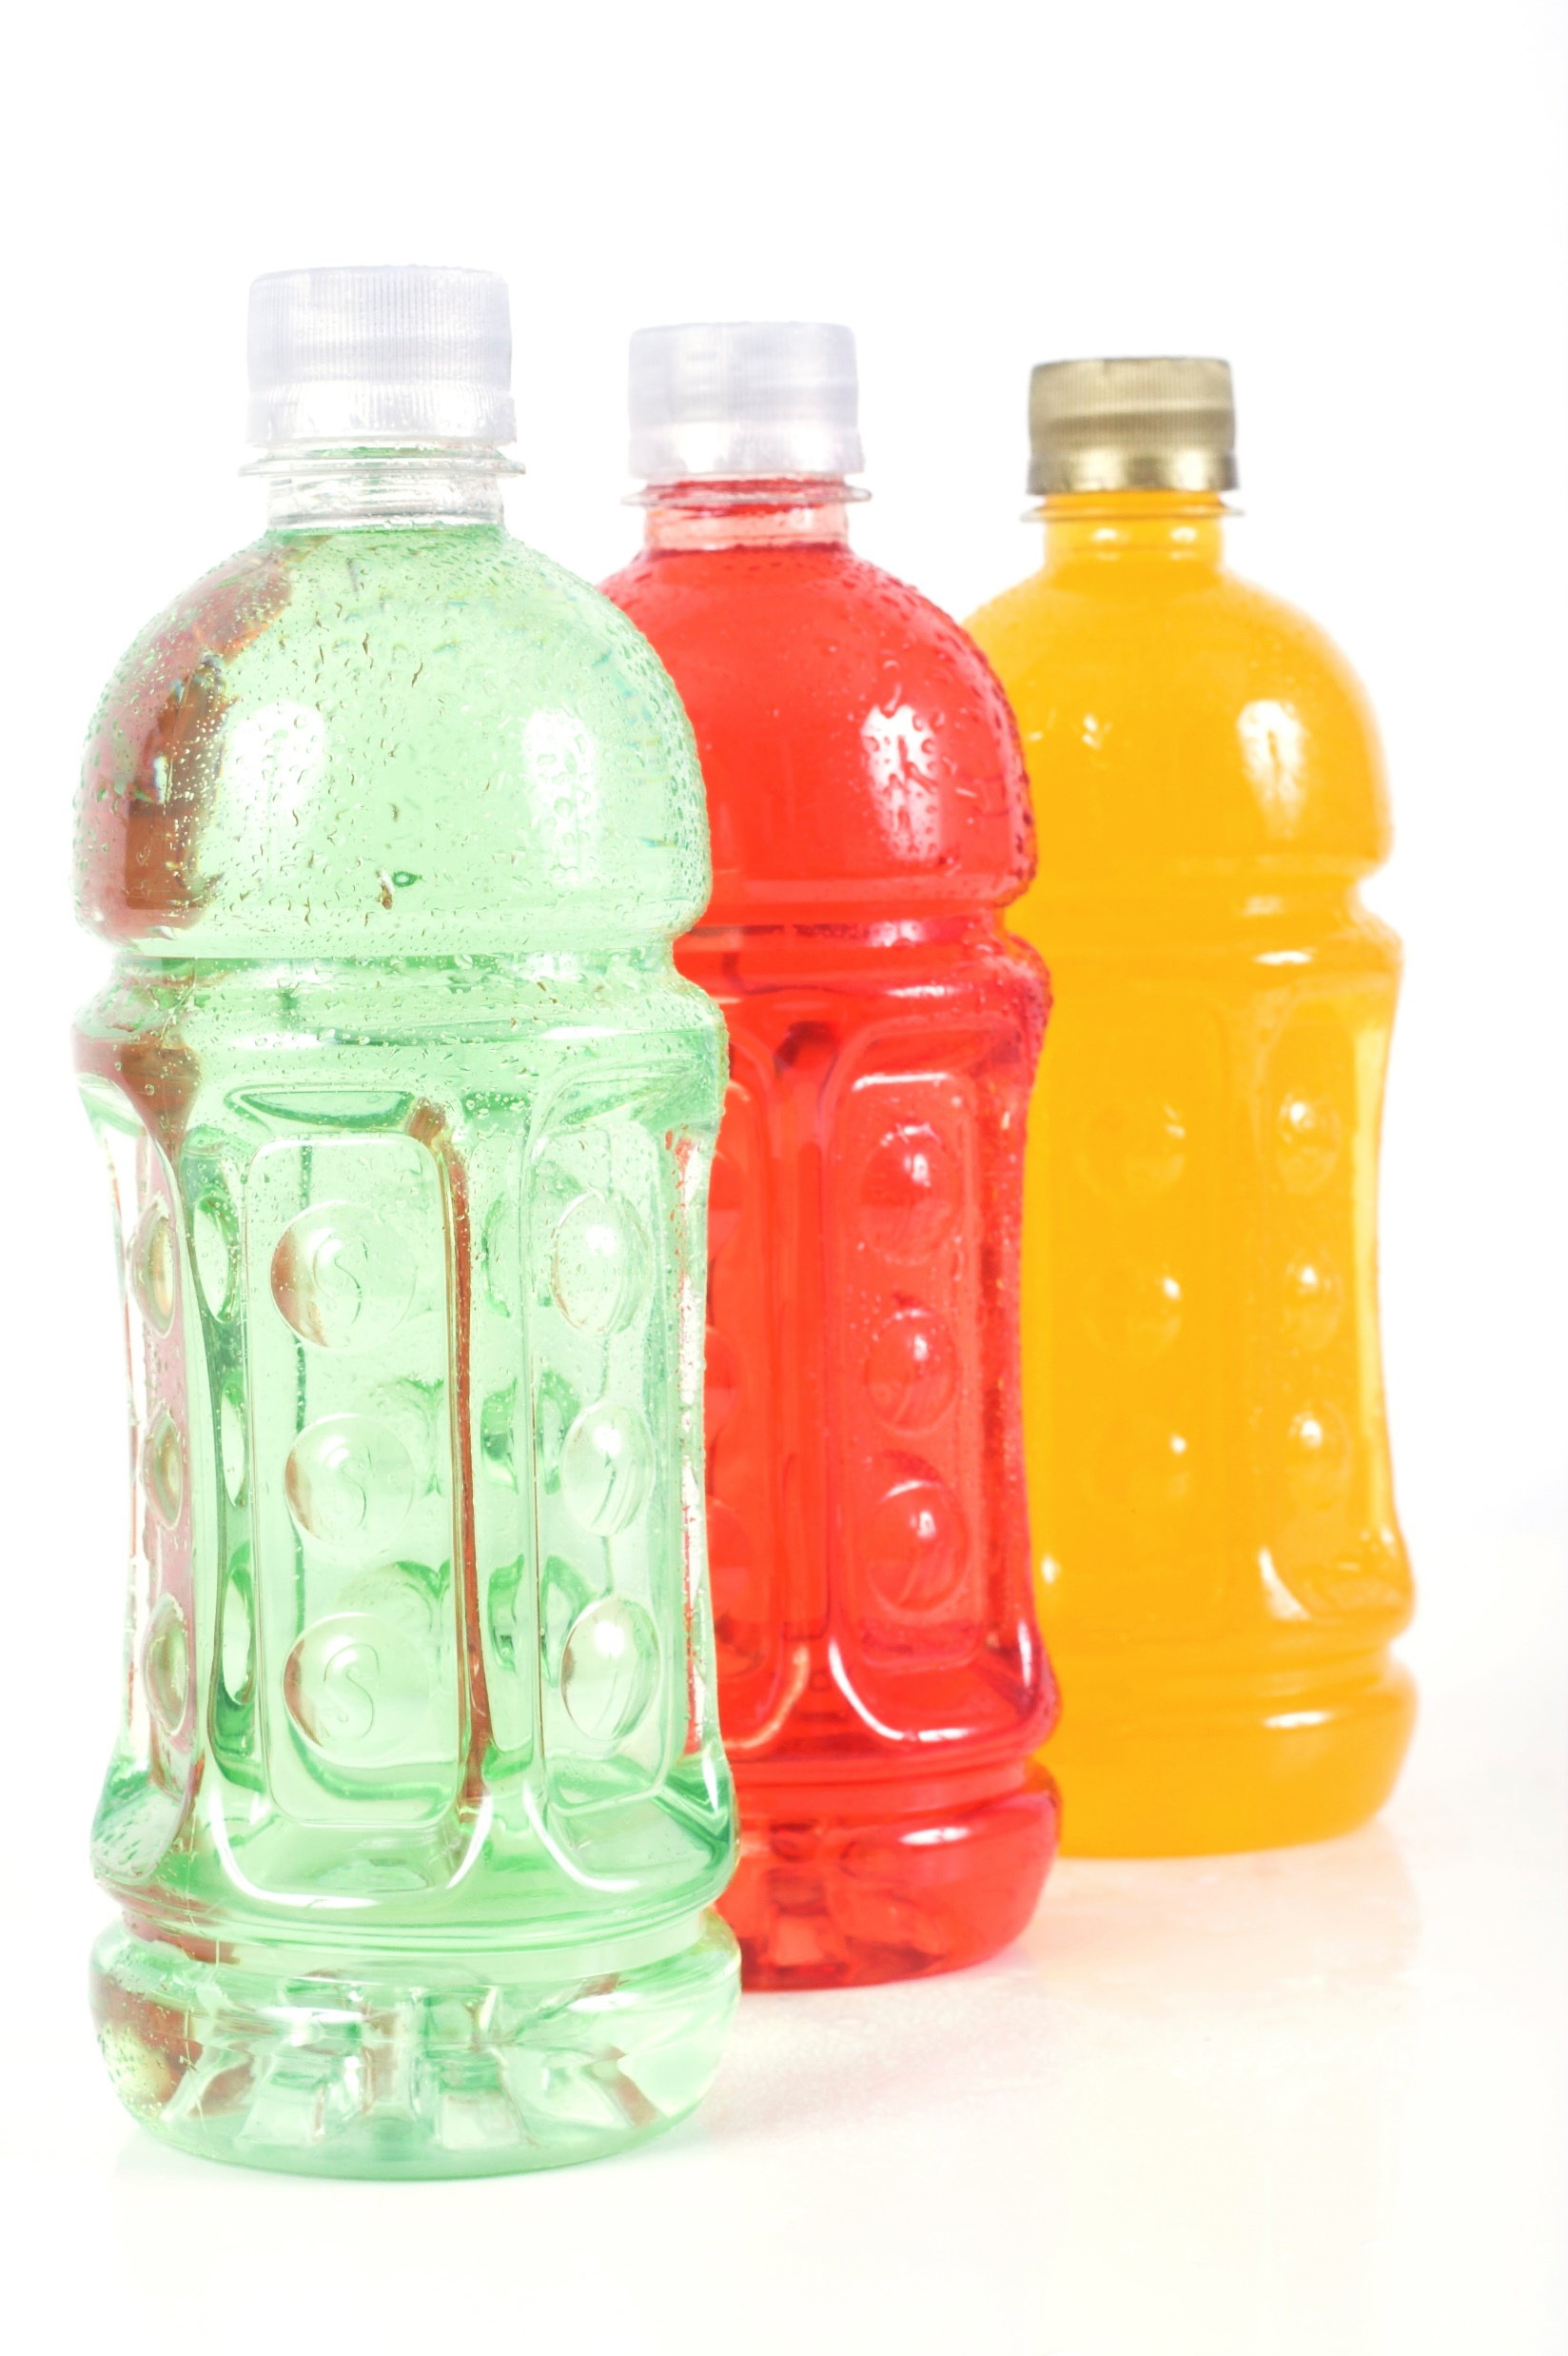
What is YOUR favorite?
What’s your favorite thing to drink?
Notes:
The purpose of this slide is to interact with the students and engage them in the presentation – by having them think about their favorite food, drink or flavor.

Slide 21
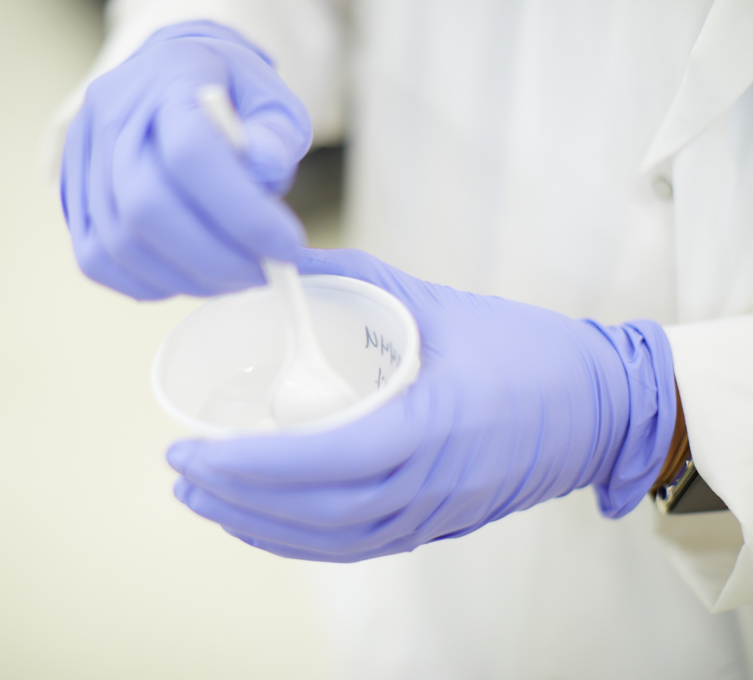
What is a chemical?
First, take a few steps back…
What is a CHEMICAL?
Notes:
Chemicals have such negative connotations.
Let's think about the rules in a chemistry class/lab.
1. no eating
2. no drinking
3. no gum
4. wear goggles
5. don't smell (unless you are told to)
6. don't look at it if it's a bright flame
7. wear goggles
8. wear gloves
9. sometimes wear clothing protection
GOSH – that makes "chemistry" sound so dangerous and makes chemicals and chemical reactions seem 'scary'
Now ask – "How many of the students have ever cooked or baked something?" They are chemists– preforming science in their own homes without the need for extreme safety measures. Now, understand, many of the Chemistry lab examples are designed to teach a wide variety of chemistry techniques and lessons, so safety is the #1 priortiy. But, playing with food, mixing flavors and colors, baking cupcakes all are chemistry too!

Slide 22
What is a chemical?
Chemicals are the backbone of everything we see, smell, touch and experience.
Chemicals can be organic, natural or artificial.
Chemicals can be toxic, neutral or healthy for us.
Chemicals can be acids, neutral pH or bases.
Chemicals are everywhere!
A chemical is made of elements.
Notes:
This is to bring to the forefront of the discussion that it's important to understand the "type of chemicals", the dose and what's actually reacting that can make things dangerous or not.
As we read through the list of bullet points about chemicals, I have the kids recall examples of toxic chemicals, or healthy chemicals. Many people don't think about Vitamin C or Protein as being chemicals.

Slide 23
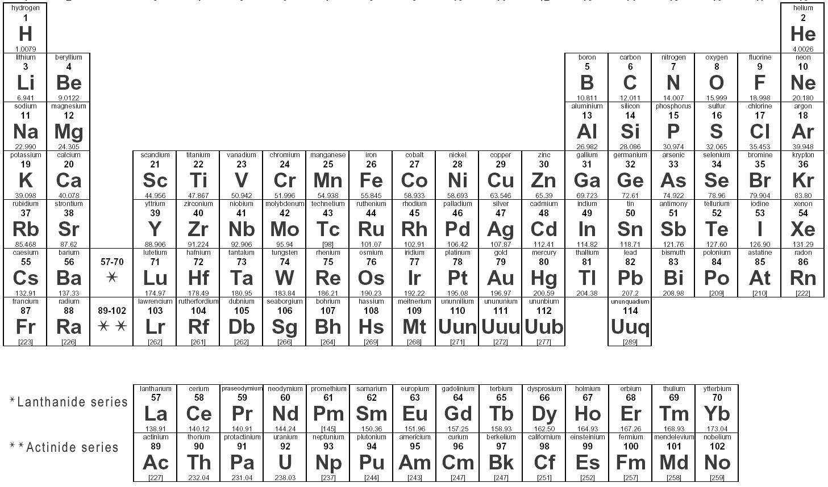
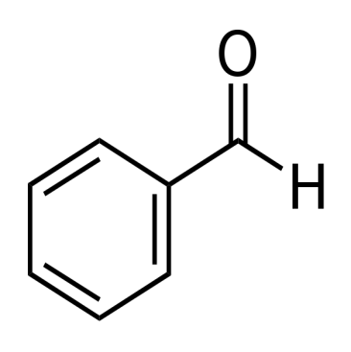
A chemical is…
A building block of a flavor...
Benzaldehyde
Notes:
This is a cherry flavor – you can pick up any brand of Cherry flavor at the grocery store.
This is the organic structure of "cherry flavor" (you don't have to use a flavor, you can use anything like Baking soda or even water, but call it by a chemical name to prove the point that It’s a chemical).
If possible, let the audience smell it, or taste it or touch it – just to prove the point that not all chemicals need to have "skull & crossbone" warnings.

Slide 24
Ted Ed Video – How do we smell?
Ted Ed Video: How do we smell? - Rose Eveleth
http://ed.ted.com/lessons/how-do-we-smell-rose-eveleth
Notes:
Pass out mints, with the directions that they shouldn't eat them until after the video – everyone will do a little experiment with the mints.

Slide 25
Let’s try it – How do you taste/smell?
Why are flavors important in food?
Notes:
Unwrap your candy or mint (but do not put it in your mouth).
Plug your nose, so no air is flowing in or out of your nose (you can still breathe with your mouth).
While plugging your nose, put the mint/candy in your mouth.
While you are sucking on the candy, your brain wants to figure out what is in your mouth & your tongue is providing answers.
What is the texture or consistency?
Is it dry, liquid, gooey?
What is the temperature?
Your tongue tastes the 5 basic tastes, but does not give any clues to what the ‘flavor’ is.
Unplug your nose!
POOF, you should have been able to detect the flavor almost instantly!
Aroma from the food = flavor
The aroma flows freely between your nose and your mouth, while in your nose the aroma compounds connect to a thin layer on the roof of your nose. Here it connects to an epithelium and sends signals to your brain with information about the food and flavor/aroma.
Within seconds of unplugging your nose, you should know what the flavor of the food is! Pretty cool, right?

Slide 26
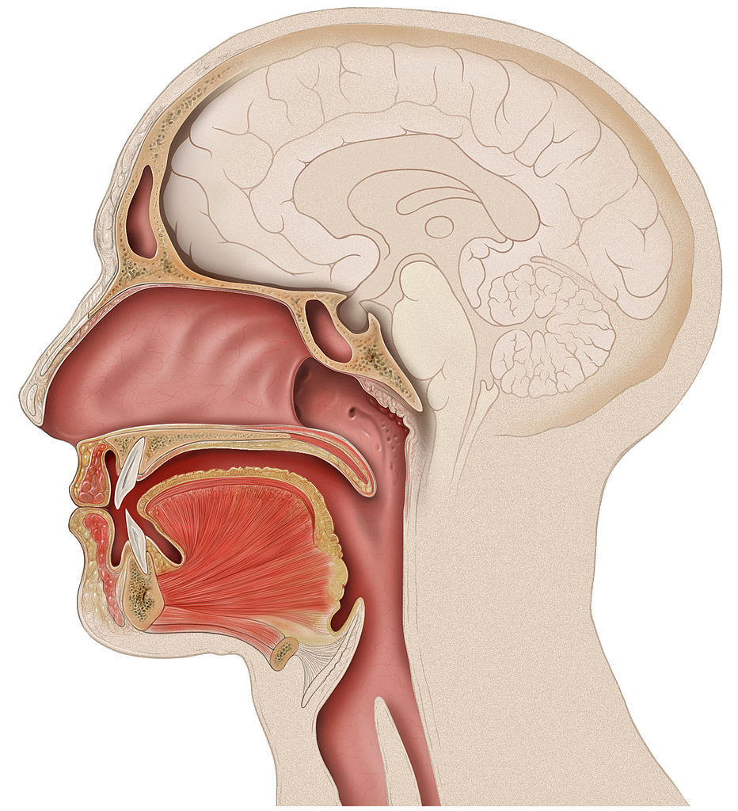
Aroma
Neuroscience:
Olfaction Routes
Orthonasal Pathway
Retronasal Pathway
Fig. 8. Cross sectional depiction of naso-oral cavity
Slide content © 2014, FONA. All rights reserved.
Notes:
There are two ways we smell -
Orthonasal – you walk in someones house and you smell brownies baking in the oven (the compound comes of the coffee and enters the nose & attaches to the epithelium, sends signals to the brain saying "that's the smell of brownies baking."
Retronasal – this is the way we just 'smelled' the mint. Mint flavors enter the mouth and are carried with your inhalation/exhalation into your nasal cavity, attach to the epithelium and send signals to the brain.

Slide 27
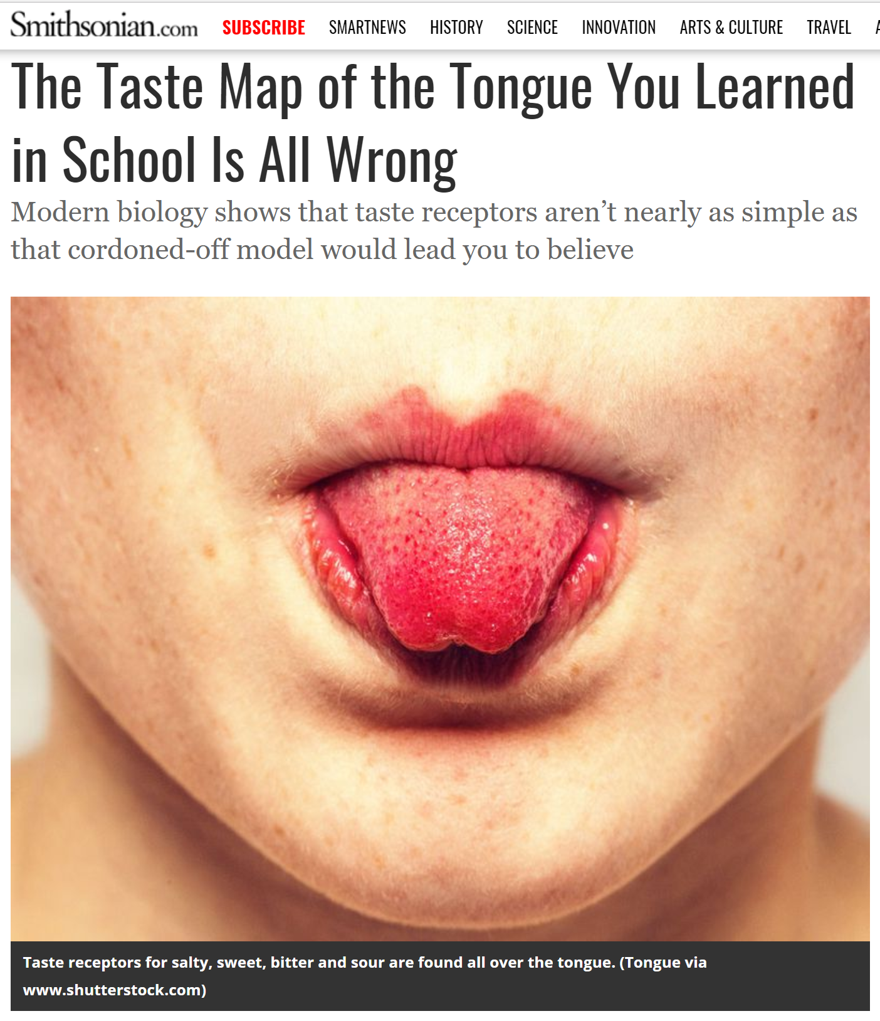
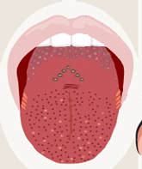
Taste
Bitter
Sour
Salt
D. Hänig 1901
(Trivedi, 2012; Martin Harvey/Getty Images)
Sweet
https://www.smithsonianmag.com/science-nature/neat-and-tidy-map-tastes-tongue-you-learned-school-all-wrong-180963407/
Notes:
One scientist in early 1900 thought there were regions of the tongue that 'tasted' the various tastes.

Slide 28
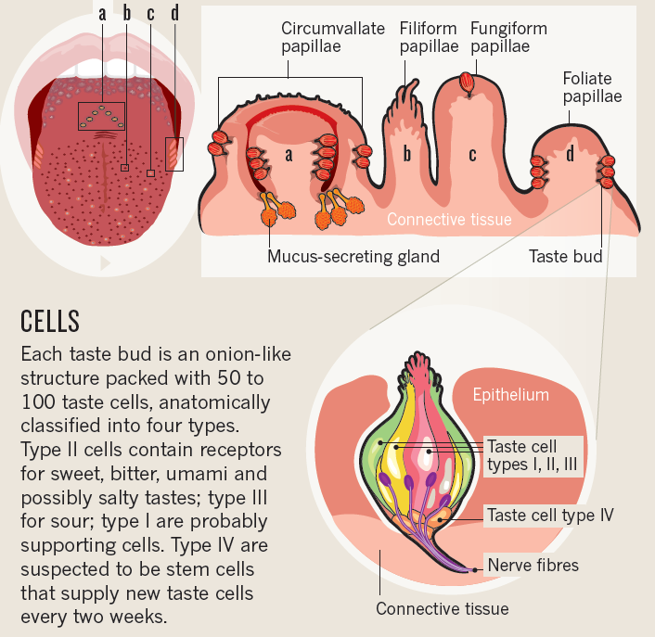
Taste –Anatomy of Gustation
Circumvallate
Ringed circle
8-14,V-shape in back
48% of total taste buds
Filiform –
Void of taste buds
Tactile response
Fungiform
Mostly at tip
18% of total taste buds
Foliate
Located at posterior
20 ridges and 600 taste buds per side
34% of total taste buds
(Trivedi, 2012; Martin Harvey/Getty Images)

Slide 29
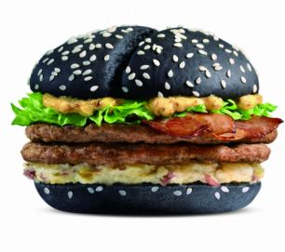
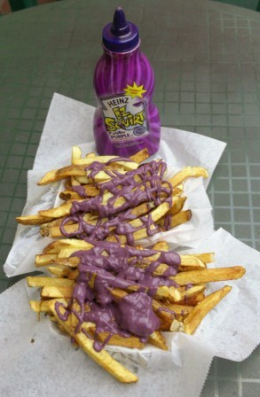
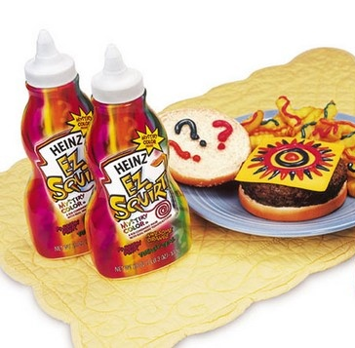
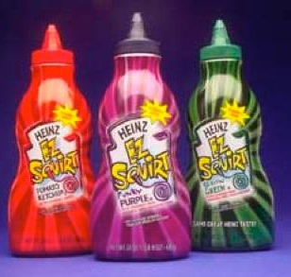
Visual Impact
Notes:
We eat with our eyes......
In the 90's color was all the rage! Gatorade & Powerade gained a lot of traction....and what Heinz Ketchup knew is that kids love color & kids love ketchup. Mix the two of them & they were going to have a market success! However, some things should not be changed.

Slide 30
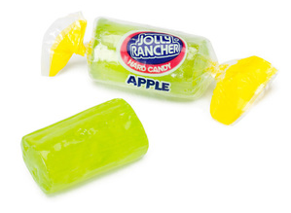
Which has more chemicals?
OR
Espino-Díaz, Miguel et al. “Biochemistry of Apple Aroma: A Review.” Food Technology and Biotechnology 54.4 (2016): 375–397. PMC. Web. 19 Feb. 2018.
https://www.ncbi.nlm.nih.gov/pmc/articles/PMC5253989/
Notes:
Let the audience guess which has more first.
The Jolly Rancher is a simple mixture of sugar, water, acid, flavor, & color.
Think about all the biological & chemical changes that have taken place with the apple before it was picked off a tree. (extracted from the article sited above: "Apple quality is determined by attributes such as appearance, firmness and flavour, as well as by the absence of physiological and pathological disorders. However, the concept of quality in fruits has evolved, and increasing attention is currently given to sensory attributes to achieve higher acceptance by consumers (1). Flavour is one the most important and distinctive features of apples, and it is determined by both taste and aroma (2, 3). While taste is mainly determined by sugars and organic acids, aroma is a complex mixture of many volatile compounds whose composition is specific to the species and often to the variety (3–5). The volatile aroma compounds in apple have been studied for more than 50 years. In this period, more than 300 compounds have been identified (6–8), with only a few that contribute significantly to the fruit aroma. They mostly include esters, alcohols, aldehydes, ketones and ethers (6). Aldehydes predominate in immature apples (8–10), but their content decreases as the fruit matures, a period in which the concentration of alcohols and esters increases, the latter being the main volatile compounds in ripe apples (11, 12). All the volatile compounds are of great importance for the complete characteristic aroma profile of apples (8). Their composition and concentration differ among varieties (4, 13, 14), and their production can also be affected by several factors before, during and after the harvest."

Slide 31
Natural Product- Chemical Ingredients
Source:
http://www.flavorfacts.org/chemistry-among-us/ OR
https://jameskennedymonash.wordpress.com/
Notes:
Try to guess what this is an ingredient statement for. Chances are you have eaten it. It is a real fruit, something you have likely eaten! It has these ingreiends and about 200 more incidental ingredients, including DNA!
It's a Banana – but just as our food has to have an ingredient statement, if our natural fruits, vegetables and meat did too, this is what it would look like – just a mixture of confusing chemicals.
**It's could spark an interesting conversation about 'diet fads' in te industry. If you can't say it, you shouldn't eat it! If you can't find the ingredient at home in your pantry, you should not eat it. If a food contains more than 5 ingredients or more, you should not eat it. But clearly, mother nature makes things way more complex than that.

Slide 32
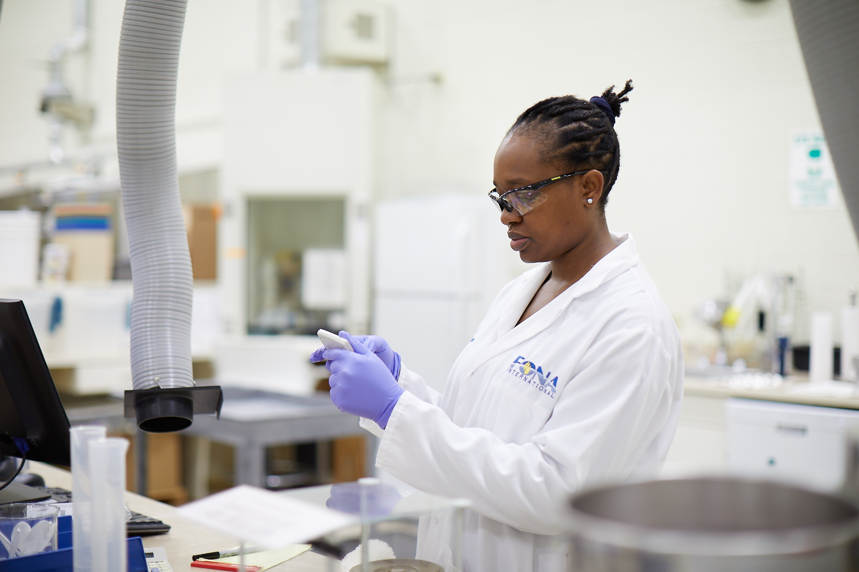
Flavors use in Food
Why would a food company use ingredients & a flavor instead of the actual food?
Desired Flavor Profile Impact
Consistency
Shelf Life
Cost

Slide 33
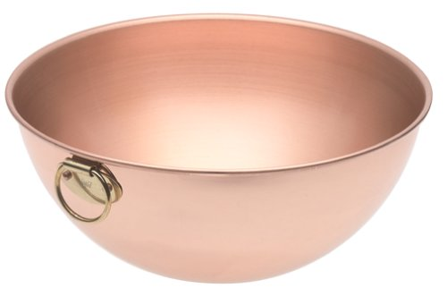
Flavor-Ingredient Interactions
Flavor
Solubility
Form
Profile
Volatility
carbohydrates
protein
minerals
fat
salt
starch
vitamins
gelatin
gum
acid

Slide 34
Lipid-Flavor Interaction
Fat affects the flavor of many foods.
1990’s Fat was BAD
Fat has a huge impact on a finished product
Visual
Aroma
Flavor
Nutrition label
Health claims
https://www.fona.com/learn/discover-fona-food-science-for-young-minds/teach-taste/

Slide 35
Lipid-Flavor Interaction
B
A
Sweetness
Fat Color Aroma
Flavor Intensity
Flavor Duration

Slide 36
Educational Application
Understanding how we interact with food involves:
Chemistry & Organic Chemistry: mixtures, density, emulsions, concentrations
Biology & Physiology/Anatomy: Senses & taste, Smell/Memory, Biologically wired to desire sweet & fat, impact of growing population, water use in agriculture
Mathematic: Statistic, data analysis, consumer preferences, concentrations/conversions, cost of food waste
Social & Cultural: social changes due to globalization of food, impact of increase middle income-globally, hunger, food waste, water usage
Economic: actual cost vs time cost as it relates to food & cooking, financial impact of globalization on small farmers and specialized products

Slide 37
Summary
The food industry is a very diverse industry!
Food manufacturing accounts for 15% of all manufacturing jobs.
Americans spend about 13% expendable income on food.
We need your students to become problem solvers!!
Engineers, Product Developers, Research Scientists, Science Communicators, Regulators, Manufacturers, Food Safety Scientists, etc!
Food is FUN.

Slide 38
Any Questions?

