Slide 1
Science of Food Educator Expo
INSERT DATE/TIME/SPEAKERS

Slide 2
Agenda
INSERT AGENDA HERE

Slide 3
Overview of IFT/Feeding Tomorrow
NAME

Slide 4
We are a network of 17,000 professionals dedicated to the science of food.
Our Mission: To advance the science of food and its application across the global food system
We are a community of 3,000 undergraduate and gradate students pursing a degree in the science of food.
Our Mission: To enrich the academic experience with diverse opportunities that empower students to achieve their full potential
We are the philanthropic arm of IFT and IFTSA. Their members are our volunteers.
Our Mission: To bring the best and brightest minds to the science of food and to help them improve the world.
Notes:
Our IFT community.

Slide 5
Develop: Advance and Promote Careers in the Science of Food Enhance and promote the knowledge of IFT members and prospective members worldwide.
Network: Establish Productive and Interactive Global Networks Engage and convene relevant stakeholders to debate, create and transfer knowledge, and communicate the latest information affecting the science of food.
Innovate: Promote Science, Technology and Their Application Be a source of influence and thought leadership for the development, application and communication of the science of food.
Advocate: Address Issues and Influence Outcomes Be the objective voice of the science of food by leveraging IFT’s members to proactively contribute evidence-based science to the public dialogue on food issues.
Include: Enable Diversity, Inclusion and Equity
Leverage D&I within IFT to advance our mission and the science of food.
IFT | SECTIONS
IFT | DIVISIONS
Notes:
Talk about 2-4 specific IFT programs and initiatives

Slide 6
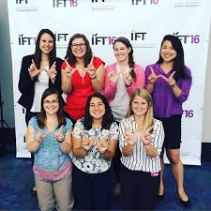
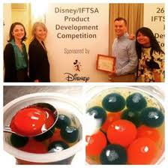
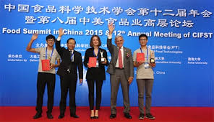
Connect: Bring people, ideas, and opportunities together to support students’ professional goals
Develop: Provide opportunities for skill development beyond the classroom and lab
Support: Cultivate friendship, mentorship, and leadership among those pursuing an education in the science of food
Notes:
Talk about 2-4 specific IFTSA program and initiatives.

Slide 7
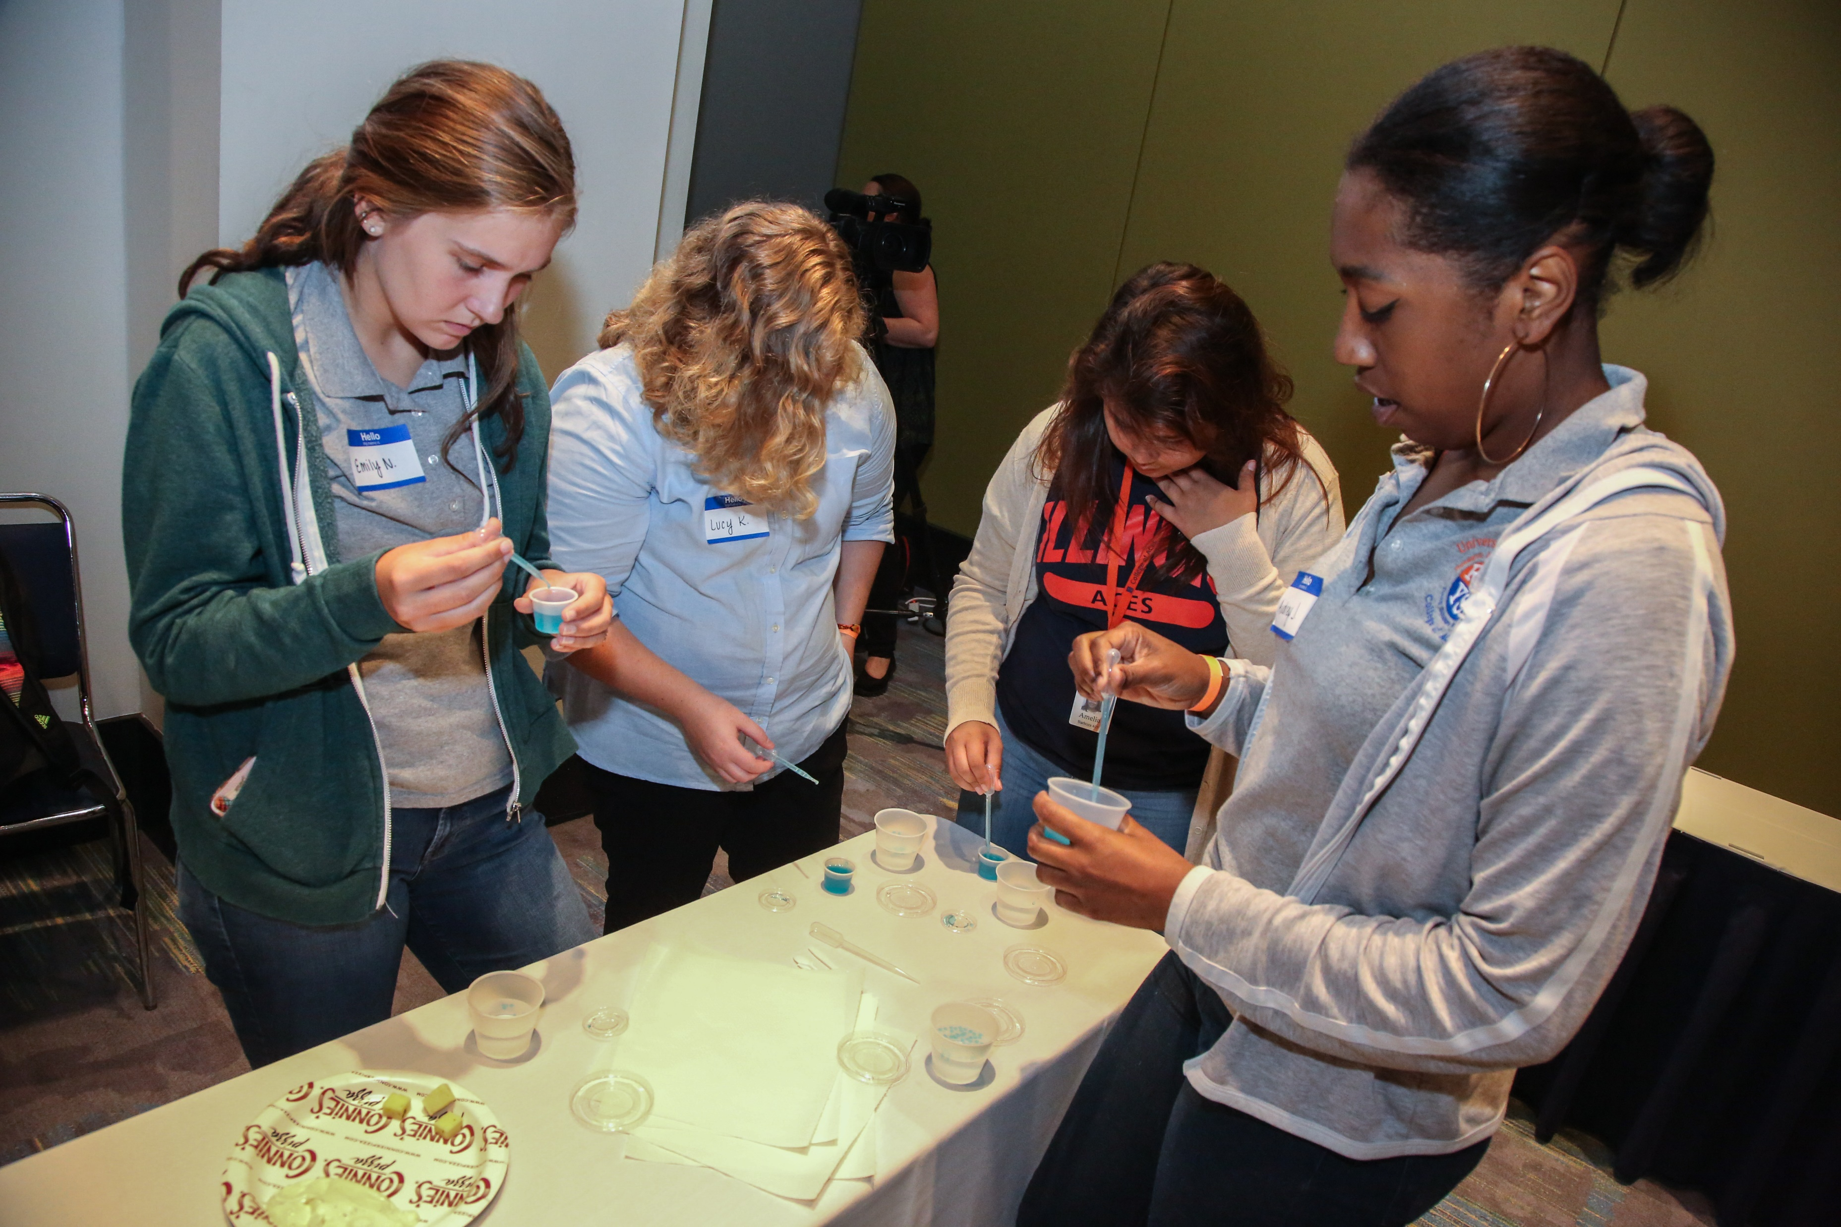
Motivate: Encourage the best young minds to pursue careers in the science of food. The world needs the brightest minds engaged in the science of food in order to meet the challenges ahead of us to feed a projected population of 9 billion in 2050.
Support: Encourage, promote and reward excellence of students pursuing careers in the science of food. Our scholarship program is one of the largest in the nation rewarding undergraduate and graduate students for their dedication to their future profession.
Leverage: Bring together the collective knowledge of our community to pursue food and nutrition solutions for those in need. Knowledge is power. And with an IFT community of over 17,000 strong, the Foundation will contribute knowledge toward food and nutrition solutions, in particular for those at the bottom of the economic pyramid.
Programs we fund and support:
Learn About Food Science
Day in the Life of Food Scientists
Science of Food Educator Expo Program
Academic & Travel Scholarships
Summer Scholars Program
Intern+ Program
Research Fellowship Program
Volunteer Globally Program
USA Science and Engineering Festival
Notes:
Talk about Feeding Tomorrow programs and initiatives (specifically motivate & support)

Slide 8
Representative: Why I Chose Food Science
NAME

Slide 9
Hands-On Experiments
NAME

Slide 10
Multimedia
NAME

